Slide 1

Demographic and Market Analysis of locations for The Dancing Dog
Andrea brice,
Cherry picking enterprises

Slide 2
Sources and Scope
LOCATION LOCATION LOCATION
These famous words make or break successful brick and mortar enterprises. This presentation includes the analysis, maps, and other information gathered for review for the owners of The Dancing Dog in Seattle, Washington. The purpose was to bring focus to the market demographics of a particular commercially zoned location so a data driven decision could be made in the site selection phase.
32 addresses were brought to the analysis. They were identified because they met the original criteria for site selection. They had:
115 Belmont Avenue E 1224 S Jackson St 2758 Alki Avenue SW 4502 42nd Ave SW 4220 SW Spokane St 9200 2nd Ave SW 1260 Republican St 601 Eastlake Ave E 1500 Westlake Ave N 505 1st Ave S 1111 E Union 810 12th Ave 1915 2nd Ave 20001st Ave 1412 1st Ave 2743 California Ave SW 3001 21st Ave S 1650 E Olive Way 231 Summit Ave E 502 Broadway 952 E Seneca St 108 1st Ave S 400 Occidental Ave S 3101 1st Ave 100 6th Avenue North 1924 E Madison St 608 19th Ave E 2319 E Madison Street 8701 14th Ave S 3228-3232 1st Ave S 2141 California Ave SW 3714 S Hudson Street
a geographic fit identified by the owners
the maximum and minimum square footaged desired for the venue
met the monthly rent limit with NNN included.
Next Steps began with data exploration for demographic and market data. Finalized sources were the U.S. Census data gathered from the Commercial MLS site for the locations of interest. This was then cross-referenced with the mined data from the ESRI Tapestry Segments information and combined with Walk Score, and Liveability scores from AreaVibes. The exploration phase continued with the development of exploratory graphs from the newly created table of information. These graphs were eventually plotted on a 3D map for final presentation.

Slide 3
Developing the Target Customer Profile
Esri’s unique combination of the 2000 and 2010 demographic data along with marketing sights have been distilled into "67 unique segments" based upon demographic and socioeconomic characteristics. The Dancing Dog is using the Esri Tapestry LifeMode Summary Groups to identify the Target Areas best suited for this venture by identifying the people who will find The Dancing Dog most interesting.
They will be those Segment Groups which belong to the Urbanization Summary Group U1 and the LifeModeSummary Group L2 or L4. They primarily belong to Segment groups identified as the "Urban Chic," "Trend Setters," "Laptops and Lattes” / "Emerald City," or the "Metro Renters." (esri.com/tapestry).
Area codes which had a predominance of population falling within these categories became the original targets. Other addresses were allowed because of other criteria, such as rent, NNN expenses, TI possibilities, etc.
The Dancing Dog is targeting these sectors with their embrace of the "foodie" culture, adventurous eating, and epicurean expectations in their drink. These well-educated consumers expect an ambience to match. This, too, will set The Dancing Dog apart. It is neither formal, nor dark and dingy.

Slide 4

The Captured Data for 32 Addresses
Includes data from the U.S. Census

Slide 5
The Captured Data for 32 Addresses also included
The Walkability Indexes
The Liveability Indexes
The Top 2 or 3 Esri Tapestry Segments

Slide 6
DASHBOARDS
A VARIETY OF METRICS REPORTED

Slide 7
Basic Demographics

Slide 8
Median Age: Rank = 1 (lower) is older
Entertainment Spending: Rank = 1 (lower) is more

Slide 9
Map Views
Leveraging the power of 3d map views and joining it with the exceptional market data found from the esri analysis

Slide 10
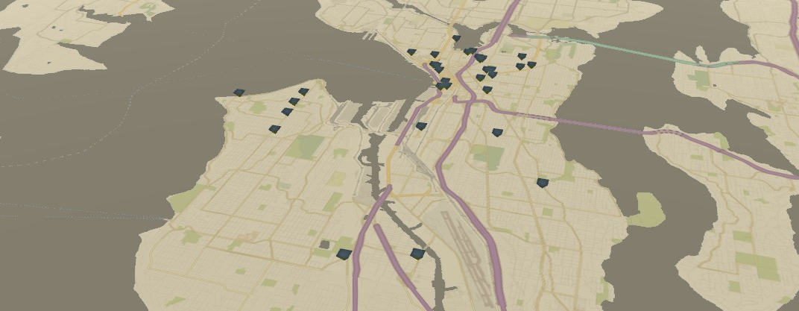
These are the mapped location possibilities for The Dancing Dog

Slide 11
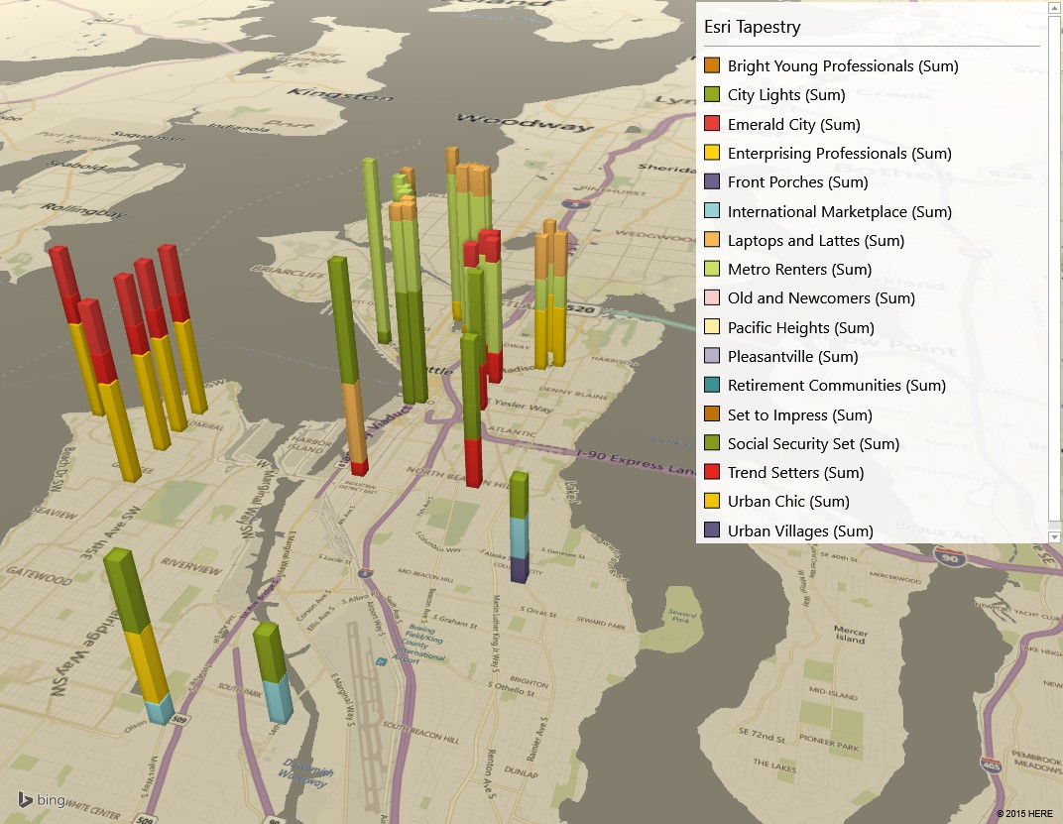
3D map views which show the distribution of Esri Tapestry Segment information per location

Slide 12
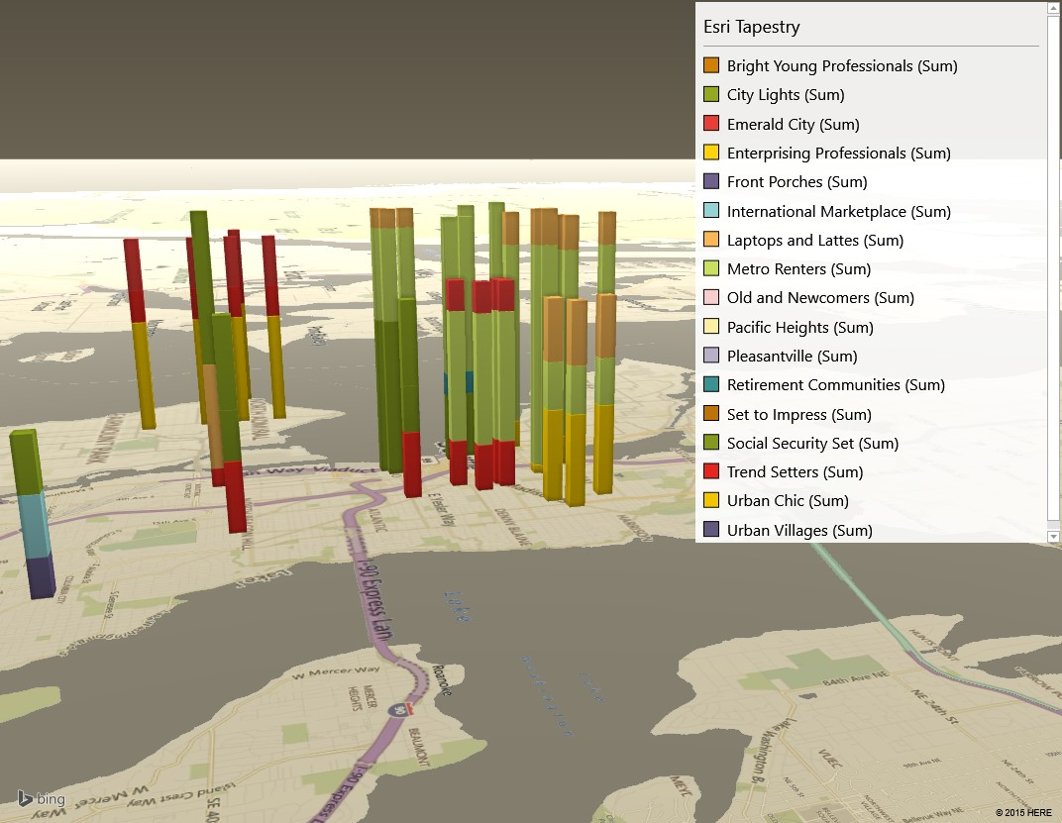
Through which the owners can rotate, zoom, and interact with.

Slide 13
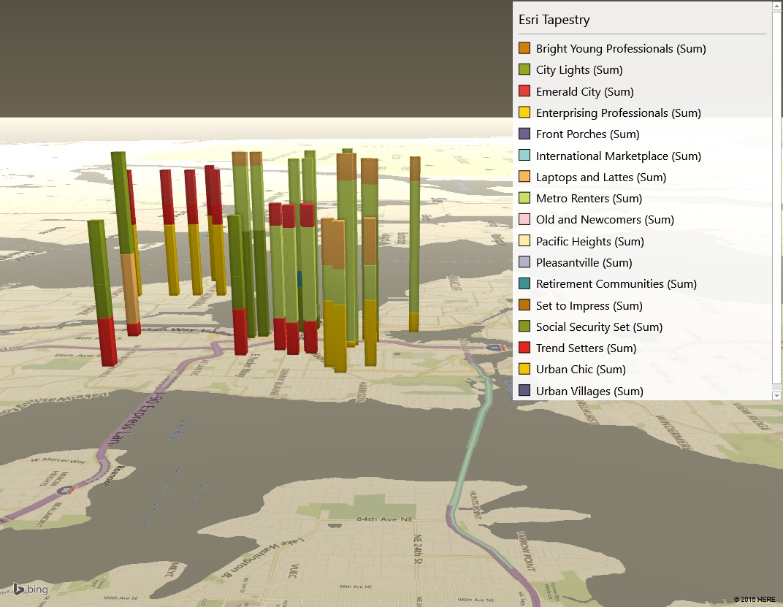

Slide 14
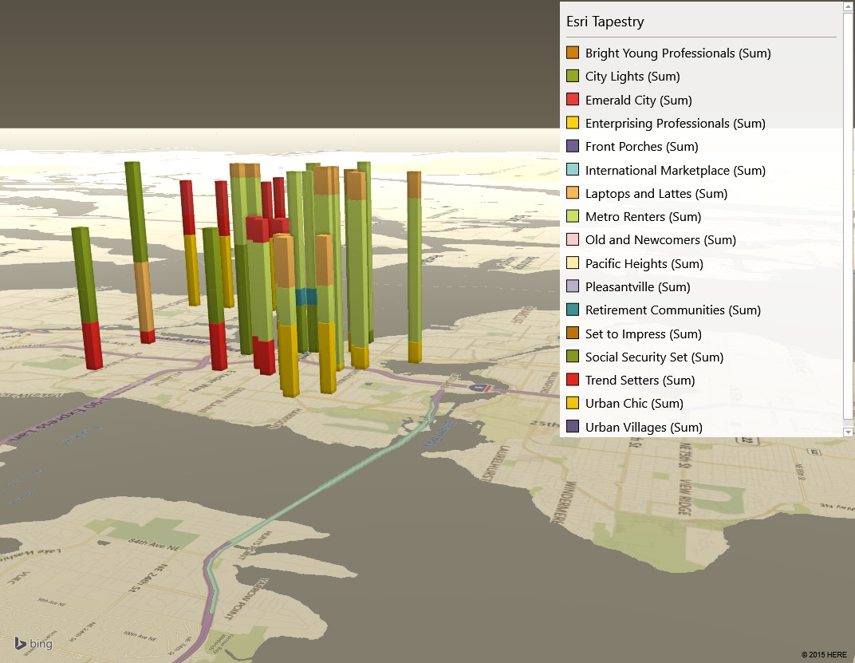

Slide 15
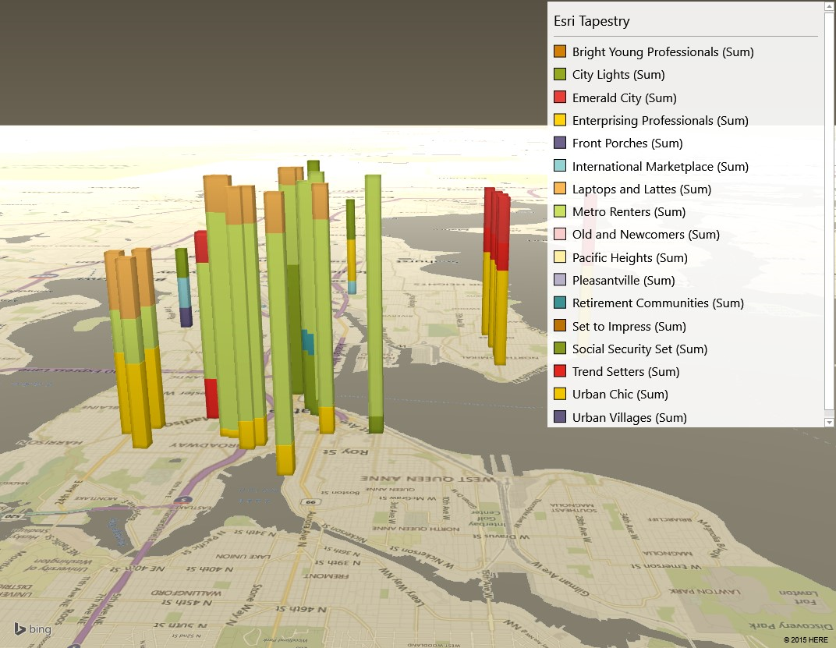

Slide 16
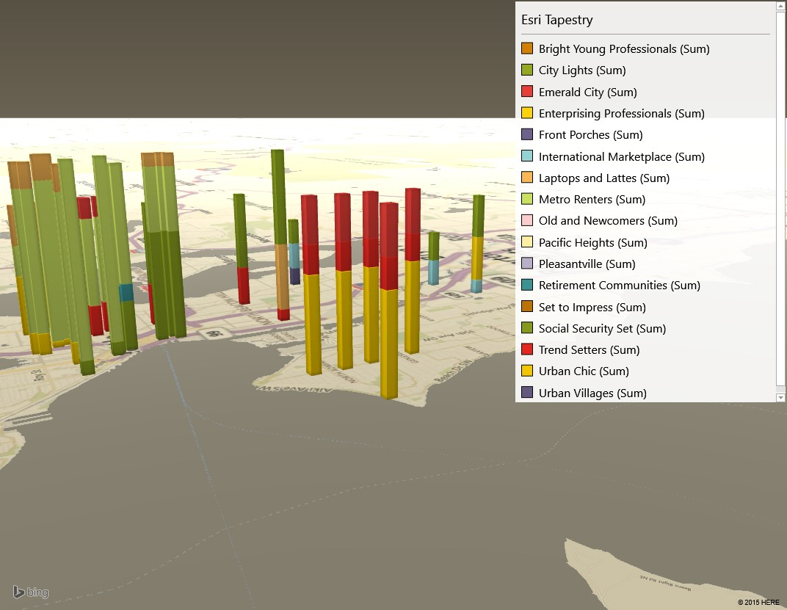

Slide 17
The Final Analysis

Slide 18
The MLS data set was used for calculating some percentages, however the Esri data was “fresher.” MLS no longer links to pdfs of the census with their new database. However, since not all values were available from Esri such as Spending rank, or a means of calculating the percent of population with income > 75K, the census data was used.

Slide 19
Summary of Lifestyle Scores
Sum Target Segments represents the summed % of the population found within the following Esri Tapestry Segments:
Urban Chic, Trend Setters, Laptops and Lattes, Emerald City, Metro Renters

Slide 20
Final demographic characteristics
Market Characteristic | Preference
Walkability Score | 80 or greater
Liveability Score | 85 or greater
% of Population w/ Income > 75K | 30%
Average (Esri) Household income | $80,000+
Per capita income | $35,000+
Median Age | 35-45
Primary diner trait | Embrace the "foodie" culture, enjoy cooking adventurous meals using local and organic foods.
Occupations | Professional, management, and sales positions in the scientific, technical services, educational services and health care industry sectors.

Slide 21
Final location selections
The final selection of 5 locations included a location which had a crime rating of “F.” The Seattle Police Report Maps and historical crime information showed no incidents in the area directly surrounding the location. Statistics such as the crime rating are zip code based. So the Madison location was not immediately removed from consideration.

Slide 22
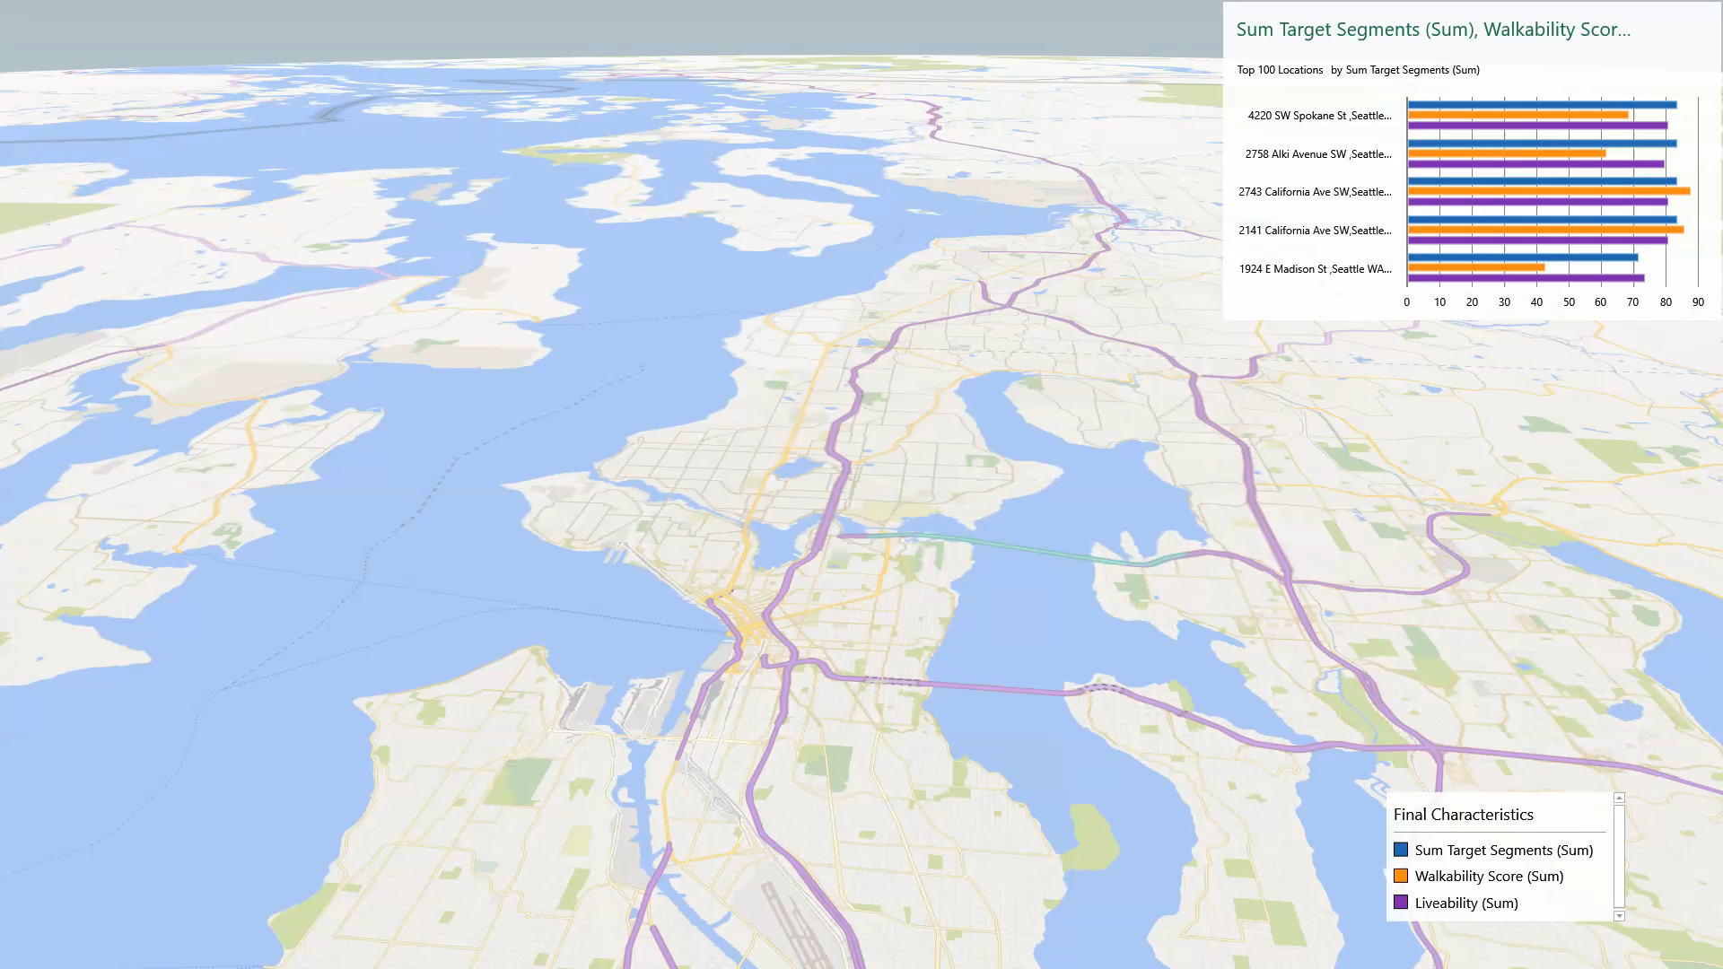
Final locations

Slide 23
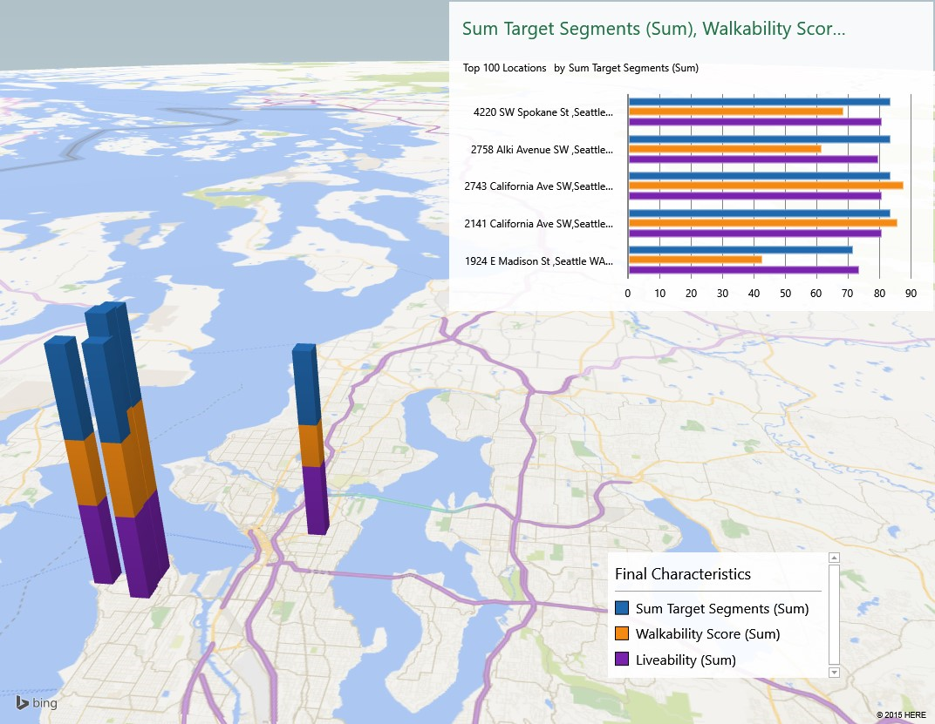

Slide 24
Reference Hyperlinks
Esri Tapestry Segments
Walkscore Walkability Scores
AreaVibes Liveability Scores
Commercial MLS
Seattle Crime Map
Seattle Crime Dashboard

